Slide 1


Slide 2


Slide 3
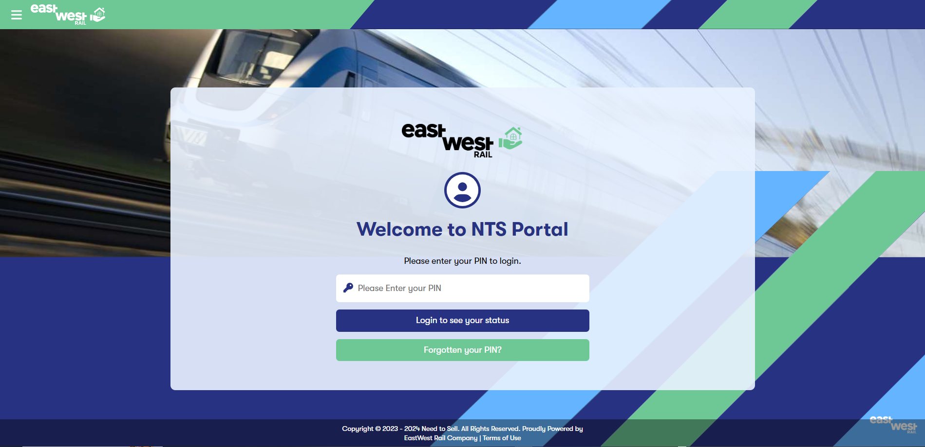

Slide 4
Table of Contents
The NTS Pages
Setup NPM and NODE.Js
Setup React
Setup the App
Run the app Locally
Adding Pages
Adding Styles
Deploy on Dev
Deploy Live

Slide 5
Open https://needtosell.eastwestrail.co.uk/. This is the login page prompted to enter your pin (Please ask
Henry to give you the URL for the SharePoint Site. Please use
https://marvelapp.com/prototype/6df0056/screen/94044587 to view the rest of the pages

Slide 6
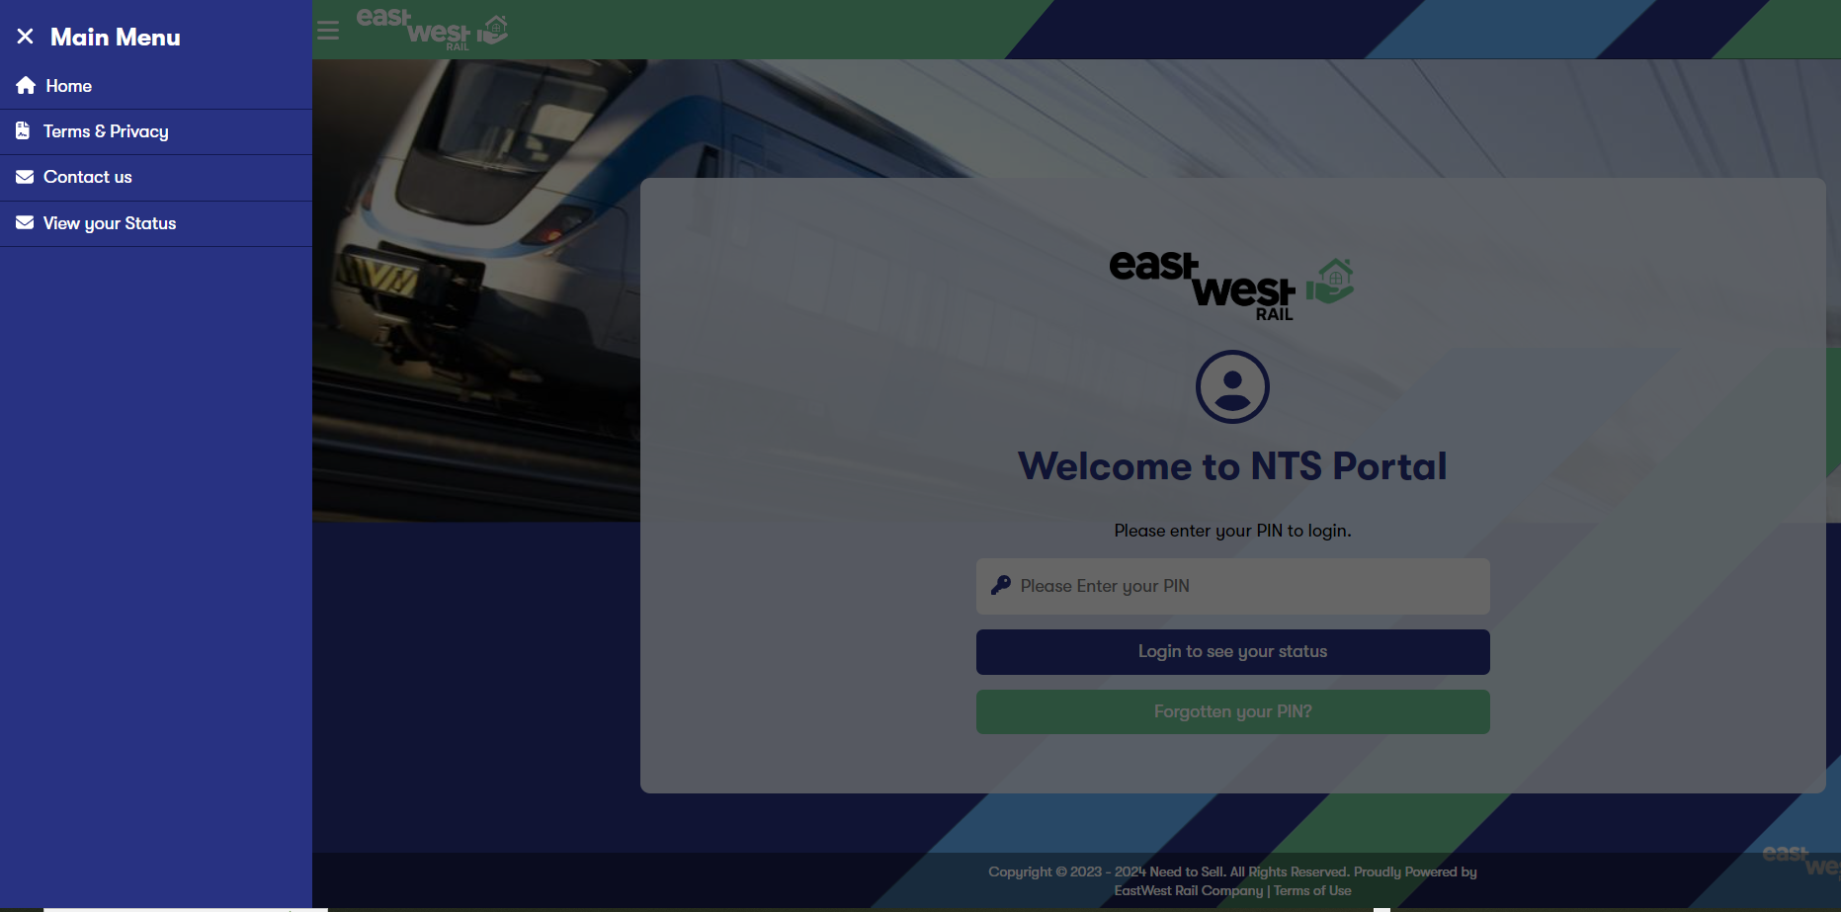
Click on the top left hand side to open the Megamenu

Slide 7
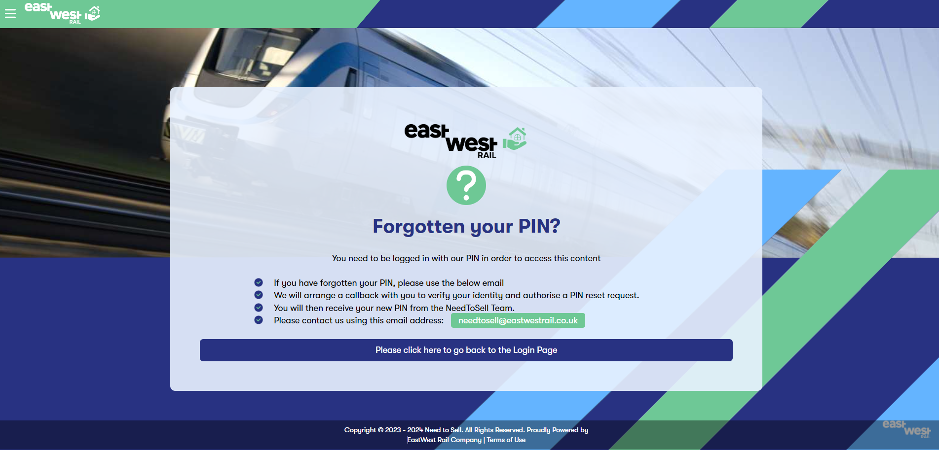
Forgotten your PIN page

Slide 8
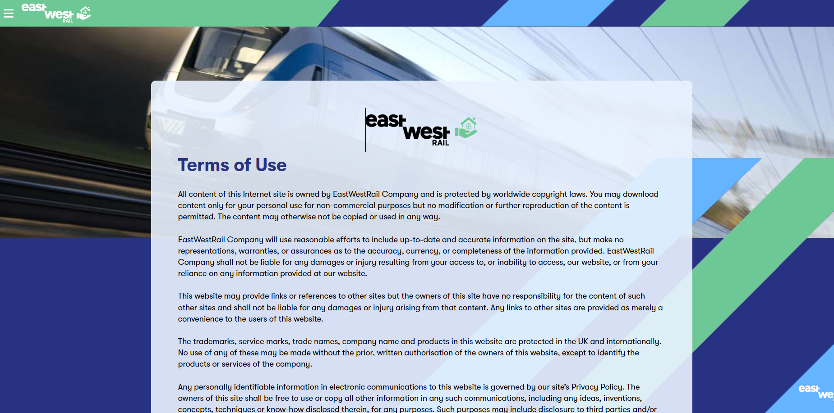
Terms and Conditions

Slide 9
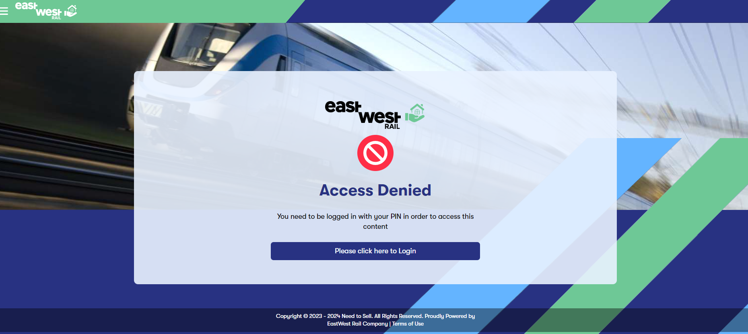
Access Denied

Slide 10
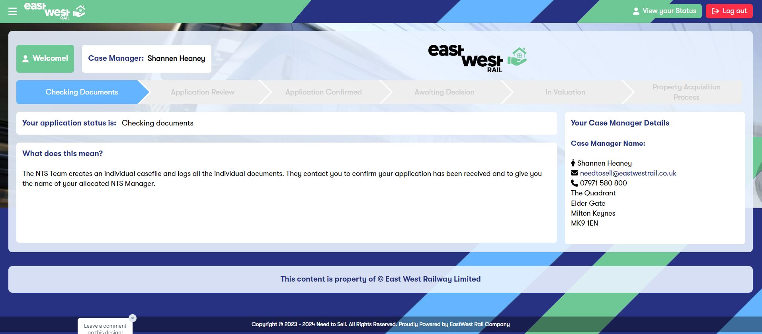
Status Page.
Once logged in you cannot go backwards and there is a 10 minute timeout of inactivity which will log you out of the
system

Slide 11
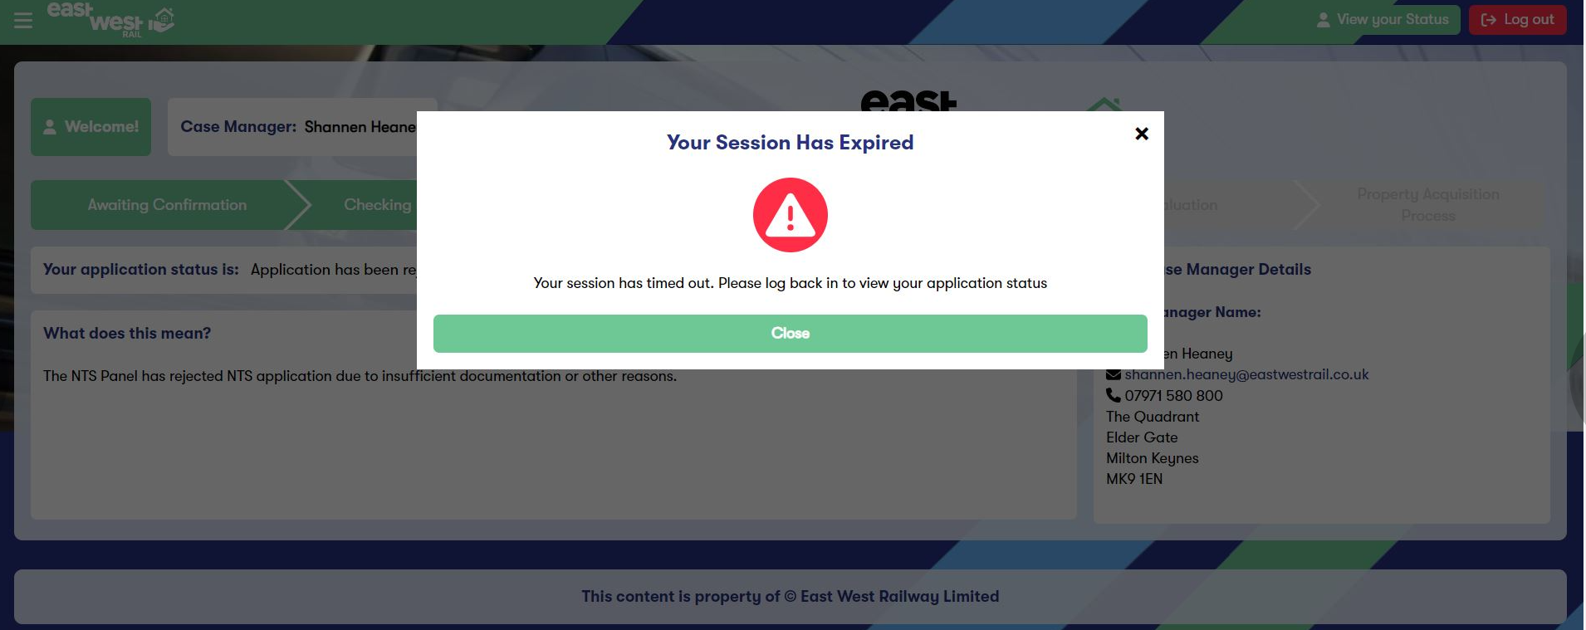
Timeout Page

Slide 12
Setup NODE.js and NPM
https://docs.npmjs.com/downloading-and-installing-node-js-and-npm
https://nodejs.org/en/download
Use the above links to Setup Node.js and NTS js
Please note that you may need to speak to Dean in IT Support AS you will need to run those commands as an administrator
TIP: Try to run this command
msiexec.exe [/i][/a][/j{u|m|/g|/t}][/x] <path_to_package>
Example: msiexe.exe /I C:\Users\Your_Username\Downloads\NPM.msi
If the above command does not run please Speak to Dean

Slide 13
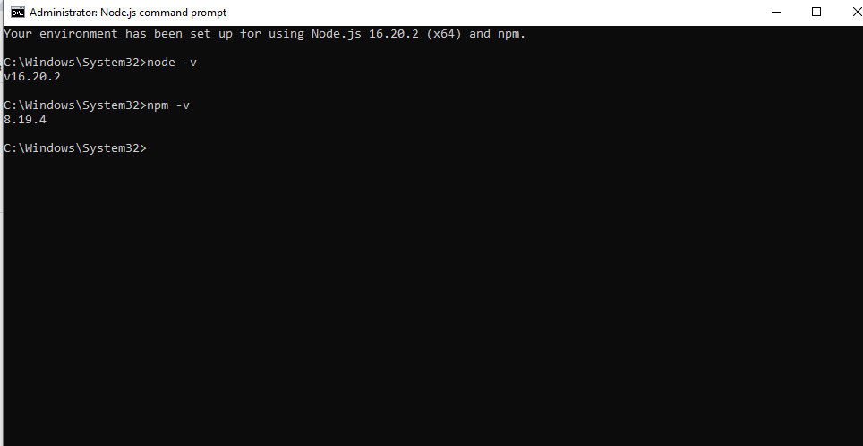
Check your Node Version

Slide 14
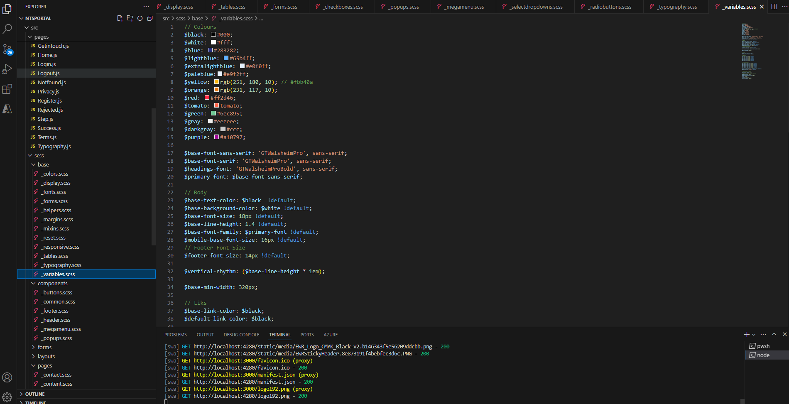

Slide 15
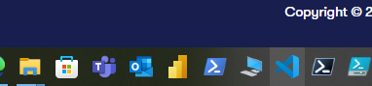
Setup React
https://code.visualstudio.com/download
Use the above links to Setup Visual Studio
Please note that you may need to speak to Dean in IT Support AS you will need to run those commands as an administrator
TIP: Try to run this command
msiexec.exe [/i][/a][/j{u|m|/g|/t}][/x] <path_to_package>
Example: msiexe.exe /I C:\Users\Your_Username\Downloads\NPM.msi
If the above command does not run please Speak to Dean

Slide 16
Pulling the App Using Github
https://github.com/git-guides/install-git
Use the above links to Install GIT
Please note that you may need to speak to Dean in IT Support AS you will need to run those commands as an administrator
TIP: Try to run this command
msiexec.exe [/i][/a][/j{u|m|/g|/t}][/x] <path_to_package>
Now PULL the NTS app using the following command (open NPM and type)
Go to https://dev.azure.com/eastwestrail-dev
If the above command does not run please Speak to Dean

Slide 17
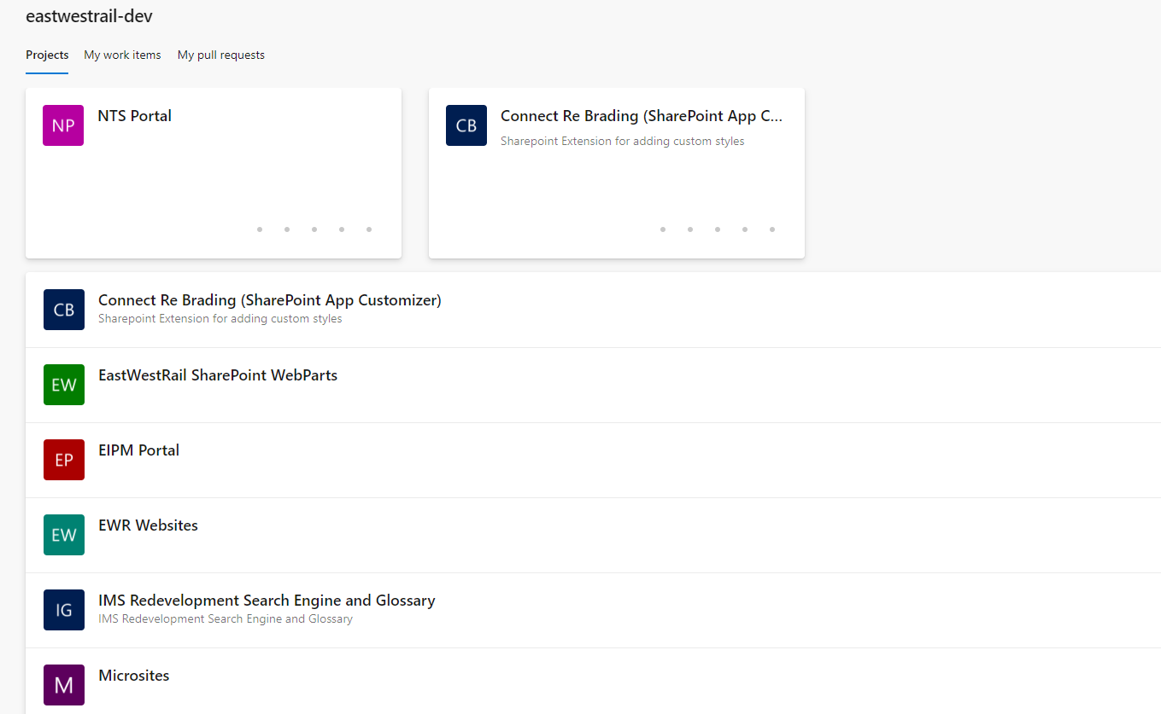
Pulling the App Using Github

Slide 18
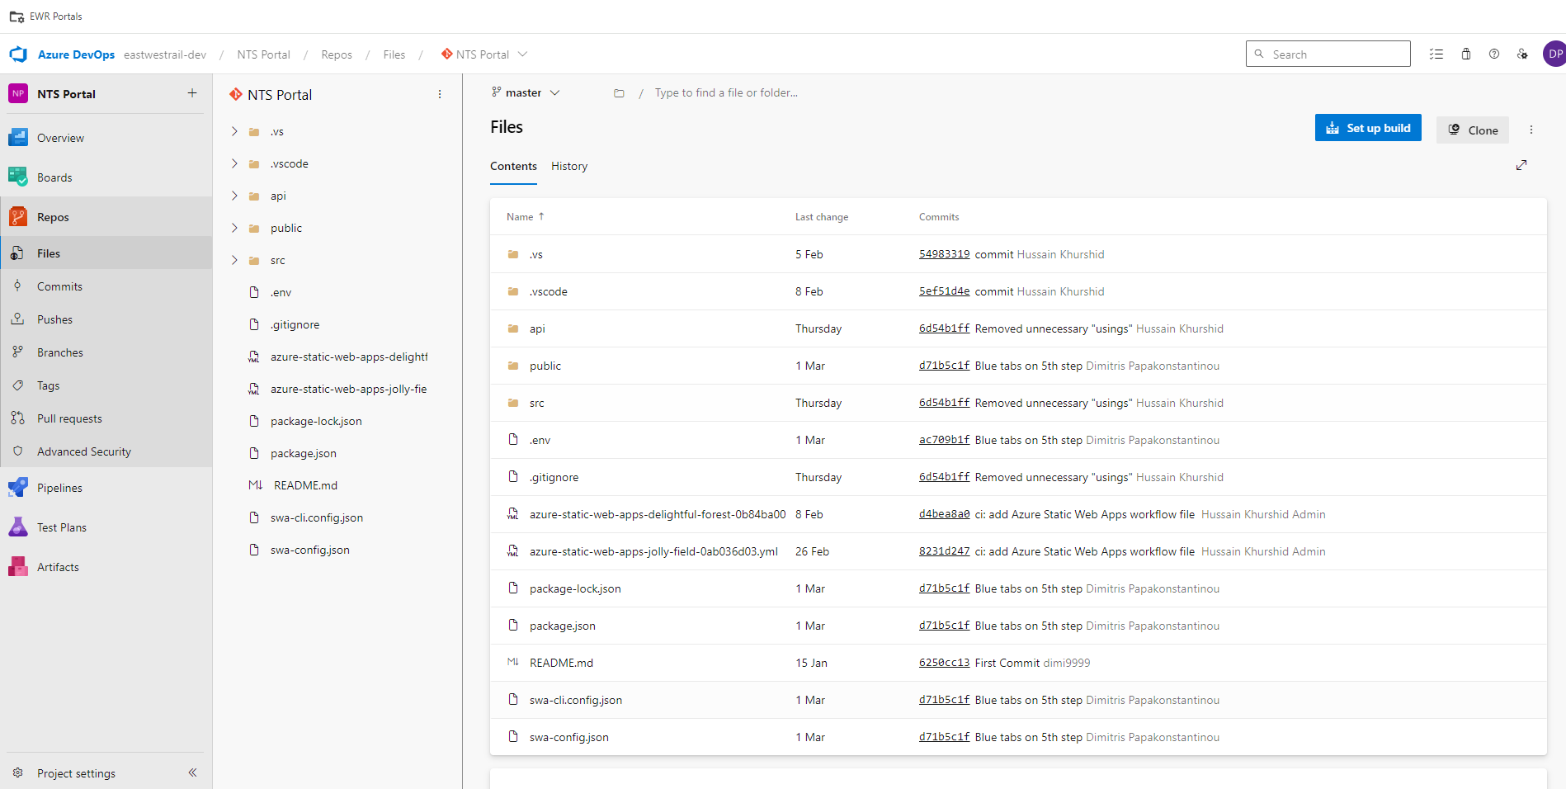
Pulling the App Using Github

Slide 19
Pulling the App Using Github
Clone the repository
Open NPM and type
git clone -https://eastwestrail-dev@dev.azure.com/eastwestrail-dev/NTS%20Portal/_git/NTS%20Portal
Then to install the npm dependencies navigate yo yhr project folder
Cd c:\NTSPortal
Type the following commands in the order written
1) npm install
2) npm install --save-dev sass

Slide 20
Using SWA
PUBLISHING THE APP STEPS
************************
https://github.com/Azure/static-web-apps-cli/issues/721
use http://localhost:4280
swa start on azure apps
1) swa login to open on the terminal
2) Open your .ev file in vs code to check details
3) add the following line:
4) yml file sjould be in the root folder
5) type swa build
6) type swa deploy -i api\bin\Release\net6.0\publish
CAUTION YOU MIGHT GET AN ERROR:

Slide 21
Publishing changes onto the dev preview environment
CAUTION YOU MIGHT GET AN ERROR:
√ Would you like to create a new Azure Static Web Apps project? ... no
✖ The provided project name "undefined" was not found.
Try this command THIS WILL DEPOLY TO STAGING ONLY:
swa deploy --app-name swa-nts-dev -i api\bin\Release\net6.0\publish
Remember to use npm ci for a clean installation in case files do not work.
STAGING URL: https://delightful-forest-0b84ba003-preview.westeurope.4.azurestaticapps.net/
LIVE URL: https://needtosell.eastwestrail.co.uk

Slide 22
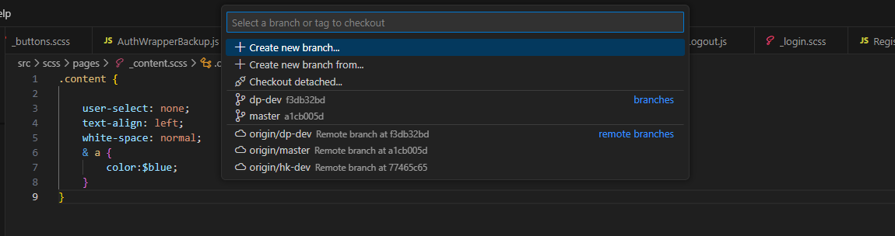
Publishing changes to live
CAUTION: Before you make ANY Changes you MUST create your own Branch.
Open Visual Studio and Create A new branch as displayed on the screenshot. Give it a name e.g. newbranch-dev
Click on the top menu Temrinal > New Terminal
Type the commands: git –checkout newbranch-dev, git pull
Once you complete your changes type the following commands: 1) git add . 2) git commit –m “Your changes explained” 3) git push

Slide 23
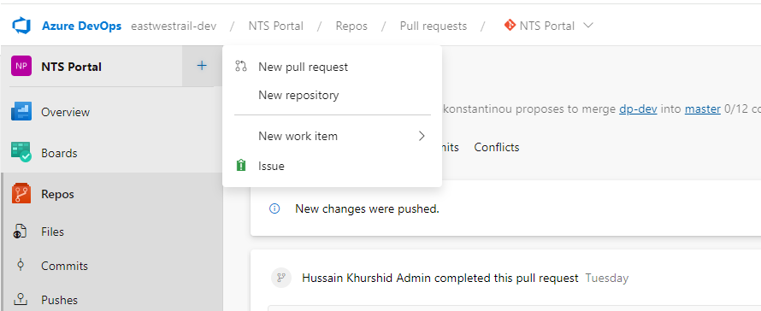
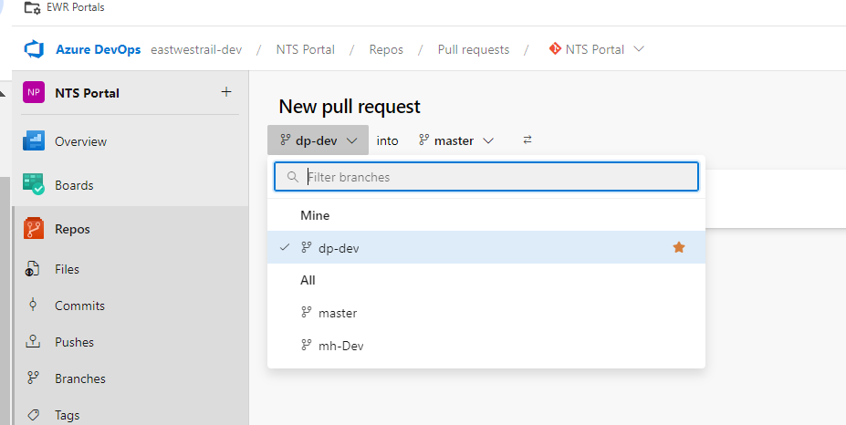
Pushing the changes to main branch
Open https://dev.azure.com/eastwestrail-dev/NTS%20Portal
Click on New Pull request
Select the source branch (your branch)
Add the changes you have made and click ok

Slide 24
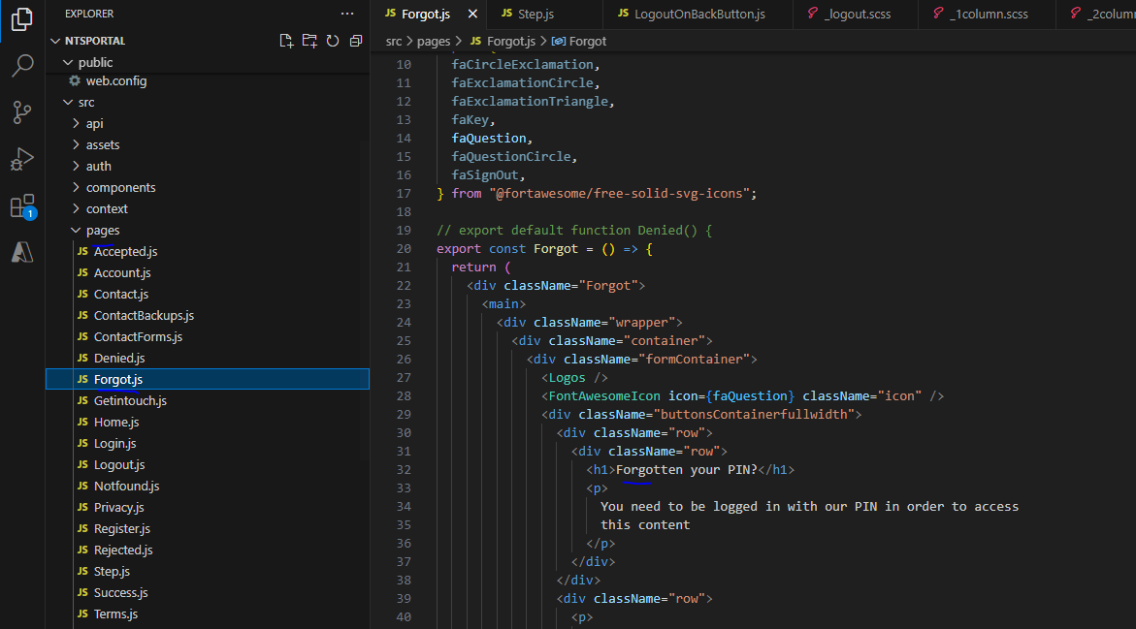
TIPS on Making Changes: Change the text
On your right hand side navigate to the folder src > Pages you will see a number of files ending with .js.
Click on any of these pages (example Forgot.js) to change the text:

Slide 25
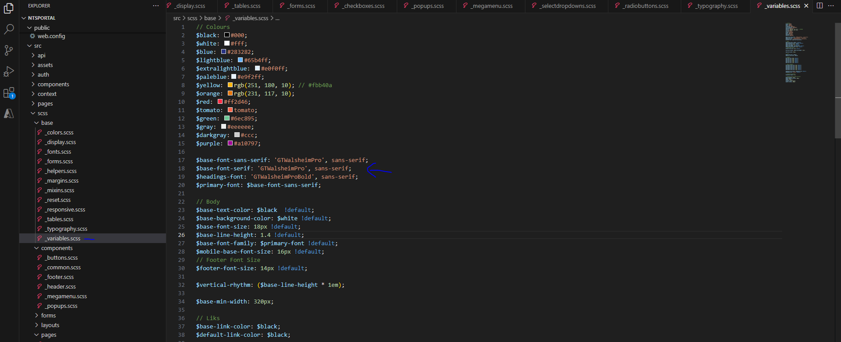
TIPS on Making Changes: Change the existing fonts
Locate the Folder scss > base and open the file variables.scss
If the font is Web safe (like Arial, Courier New Etc) simply replace the name between the single ‘’ quotes, but leave sans-serif. $headings-font will change the font of the headings and titles only while base-font will change the body text. Example $base-font-sans-serif: ‘Arial’, sans-serif;
You can also add a custom font by adding the name ‘Roboto’. Please refer to the next section adding custom fonts

Slide 26
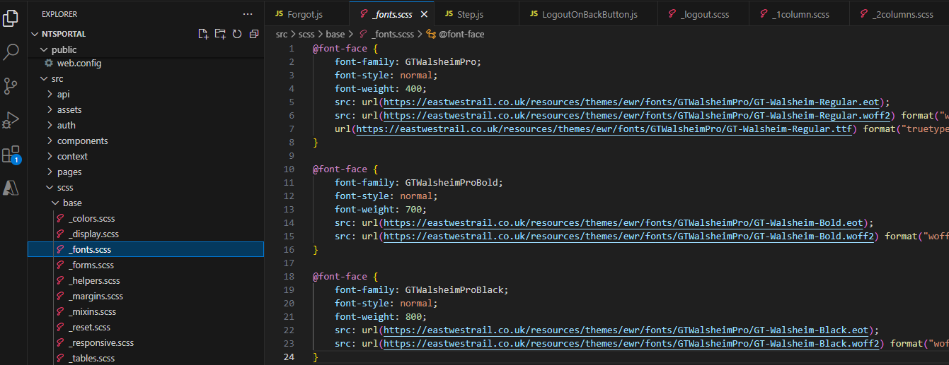
TIPS on Making Changes: Adding custom fonts
Locate the scss > base folder
Click on fonts.scss
DO NOT remove the existing code instead add your own fonts here
TIP: add comments like /* CHANGE DATE MADE START */

Slide 27
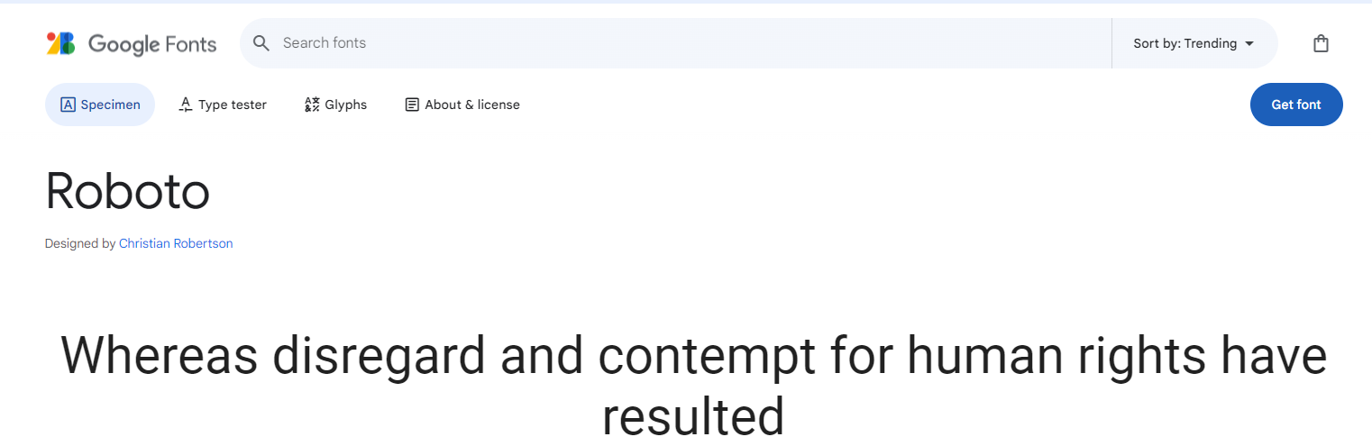
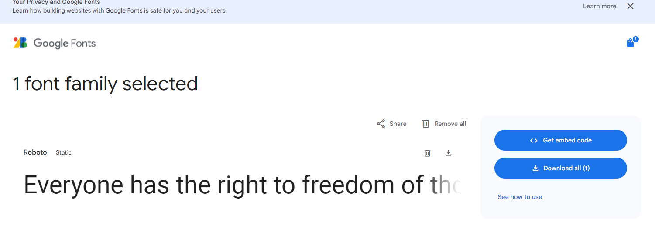
TIPS on Making Changes: Adding custom fonts
If you need to add a CUSTOM NEW google font go to https://fonts.google.com/
Select the font for example lets use ‘Roboto’
Select “get font” > Get embed code

Slide 28
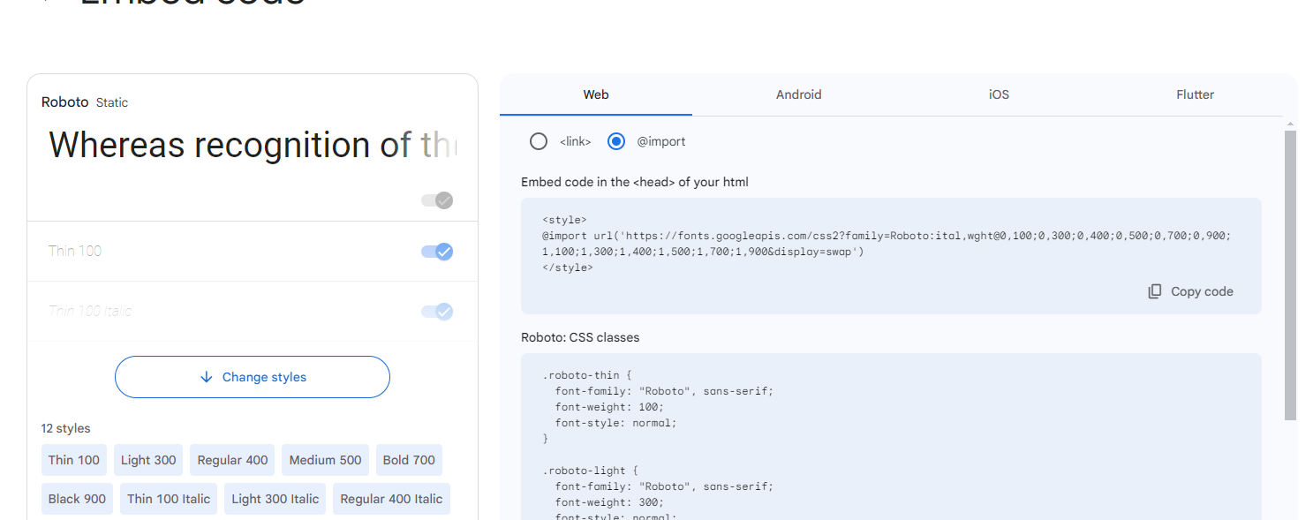
TIPS on Making Changes: Adding custom fonts
Go to web and copy the import code
CAUTION: DO NOT COPY the <style> tags copy only the @import statement and add it to the fonts.scss file:
@import url('https://fonts.googleapis.com/css2?family=Roboto:ital,wght@0,100;0,300;0,400;0,500;0,700;0,900;1,100;1,300;1,400;1,500;1,700;1,900&display=swap’)

Slide 29
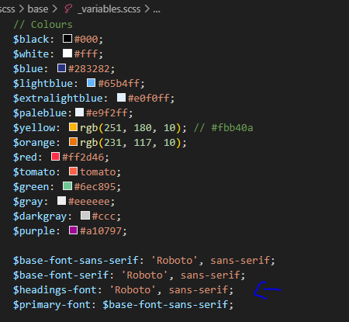
TIPS on Making Changes: Adding custom fonts and replace current
@import url('https://fonts.googleapis.com/css2?family=Roboto:ital,wght@0,100;0,300;0,400;0,500;0,700;0,900;1,100;1,300;1,400;1,500;1,700;1,900&display=swap');
COPY the above code in your fonts.scss file
Go to the variables.scss file and replace the current font : (THIS WILL REPLACE FONTS GLOBALLY)

Slide 30
TIPS on Making Changes: Adding custom fonts
If you need to add a separate element with a different font add an id or class:
Then apply this class to the page using the tag <div className=“roboto-thin”>
roboto-thin { font-family: "Roboto", sans-serif; font-weight: 100; font-style: normal; } do this on the main.scss file

Slide 31
TIPS on Making Changes: Change the brand colours
Locae the colours in variable.scss and
Simply change the codes to whatever you like (if requested)
These are all strictly EWR Brand colours and it is suggested to avoid changing them

Slide 32
Adding a new page
Go to folder Pages and create a new .js file and give the name of your preference. Example Newpage.js
Copy the following code:
// 1. Importing Components
import { Link, useMatch, useResolvedPath } from "react-router-dom";
import Logos from "../../src/components/Logos";
import NavBar from "../../src/components/Navbar";
import { AuthData } from "../auth/AuthWrapper";
// 2. Import FontAwesome Icons
import { FontAwesomeIcon } from "@fortawesome/react-fontawesome";
import { faKey, faSignOut, faSmile } from "@fortawesome/free-solid-svg-icons";
// export default function Forgot() {
export const Newpage = () => {
const { user } = AuthData();

Slide 33
Adding a new page
return (
<div className=“Newpage">
<main>
<div className="wrapper">
<div className="container">
<div className="formContainer">
<Logos />
<FontAwesomeIcon icon={faSmile} className="icon" />
<div className="buttonsContainer">
<div className="row">
<div className="row">
<h1>Page Title</h1>
<div>Content</div>
</div>
</div>
</div>
</div>
</div>
</div>
</main>
</div>
);
};

Slide 34
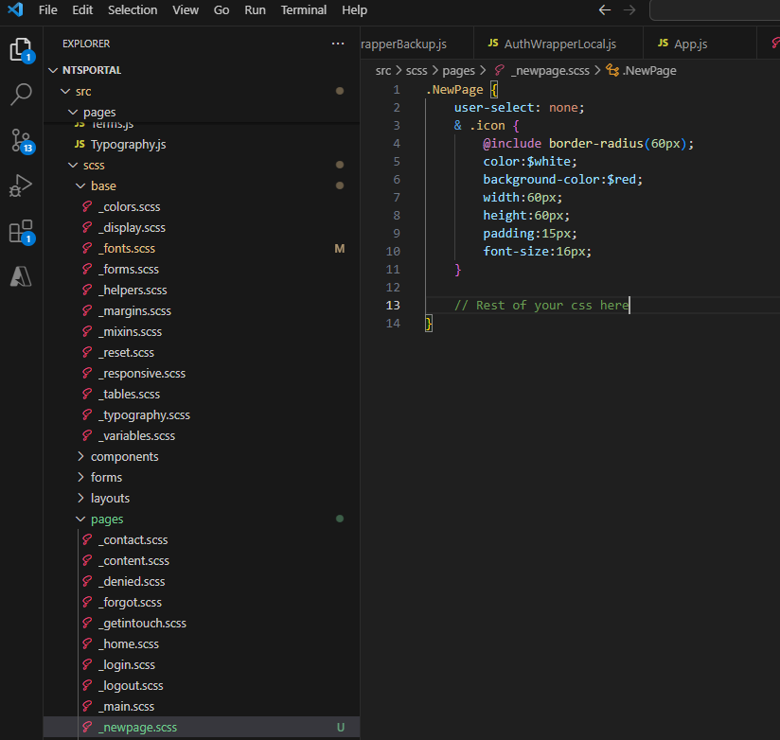
Adding a new page
CAUTION: Make sure that the const name and className on the top of the code have EXACTLY the same name
Νοw go to the scss folder locate pages and create a new .scss file. Name it with the same name as your page and add the scss code as shown in the screenshot.

Slide 35
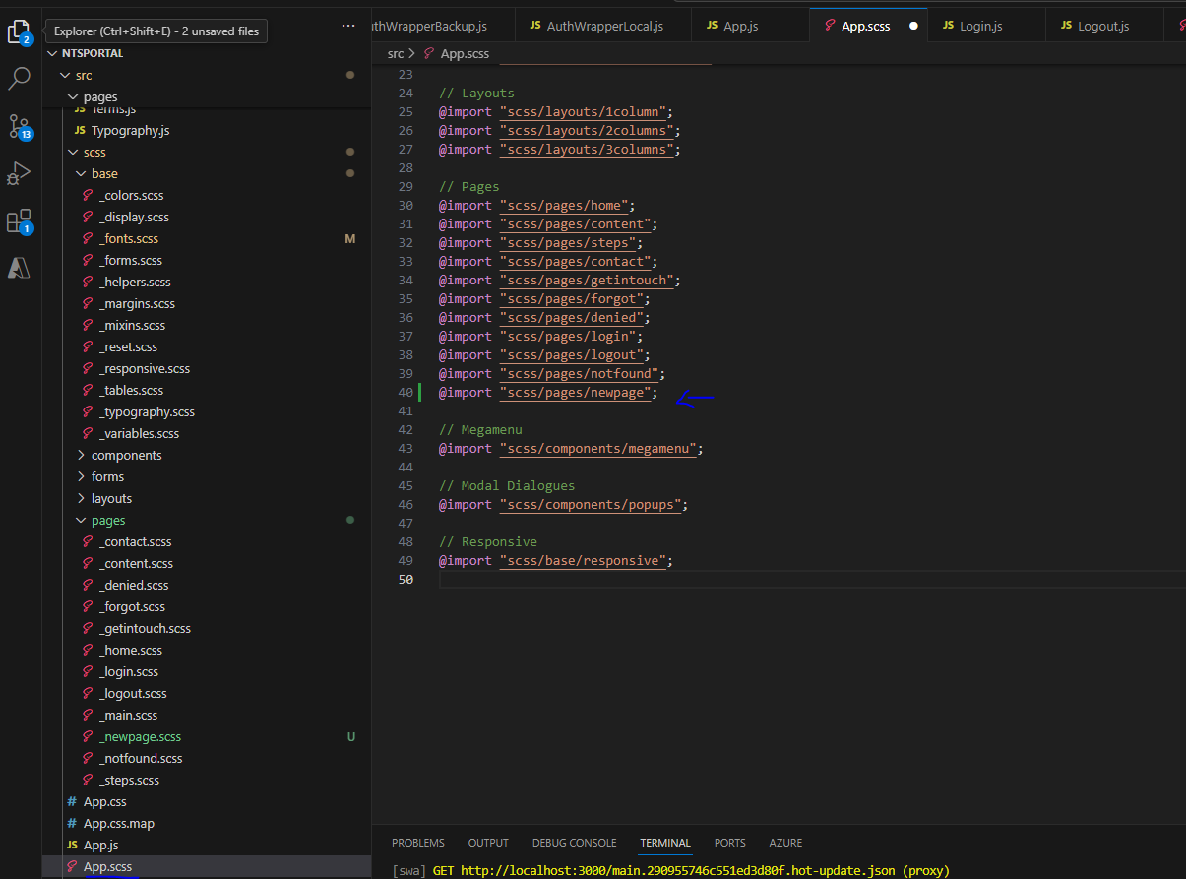
Adding a new page
Now we need tro make sure that the new page styles are rendered properly. In order to do that locate the app.scss file in the root scss folder and add the following line of code. Save and the new page will be ready to test
@import "scss/pages/newpage";

Slide 36
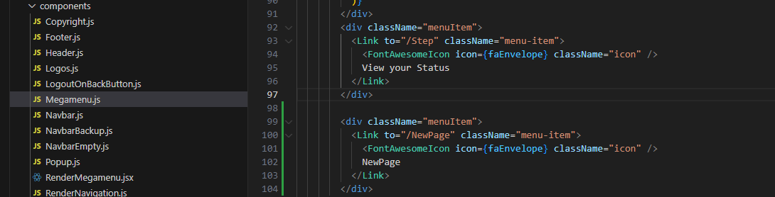
Adding the page on the megamenu
Locate the Megamenu.js file in the components folder and add the following code:
<div className="menuItem">
<Link to="/NewPage" className="menu-item">
<FontAwesomeIcon icon={faEnvelope} className="icon" />
NewPage
</Link>
</div>

Slide 37
Changing the text of the status
Open https://eastwestrailwaycouk.sharepoint.com/NTSdev/
Locate the Status Column to change the text
Before doing so ask Henry Wright to assist

Slide 38


Slide 39


